Slide 2
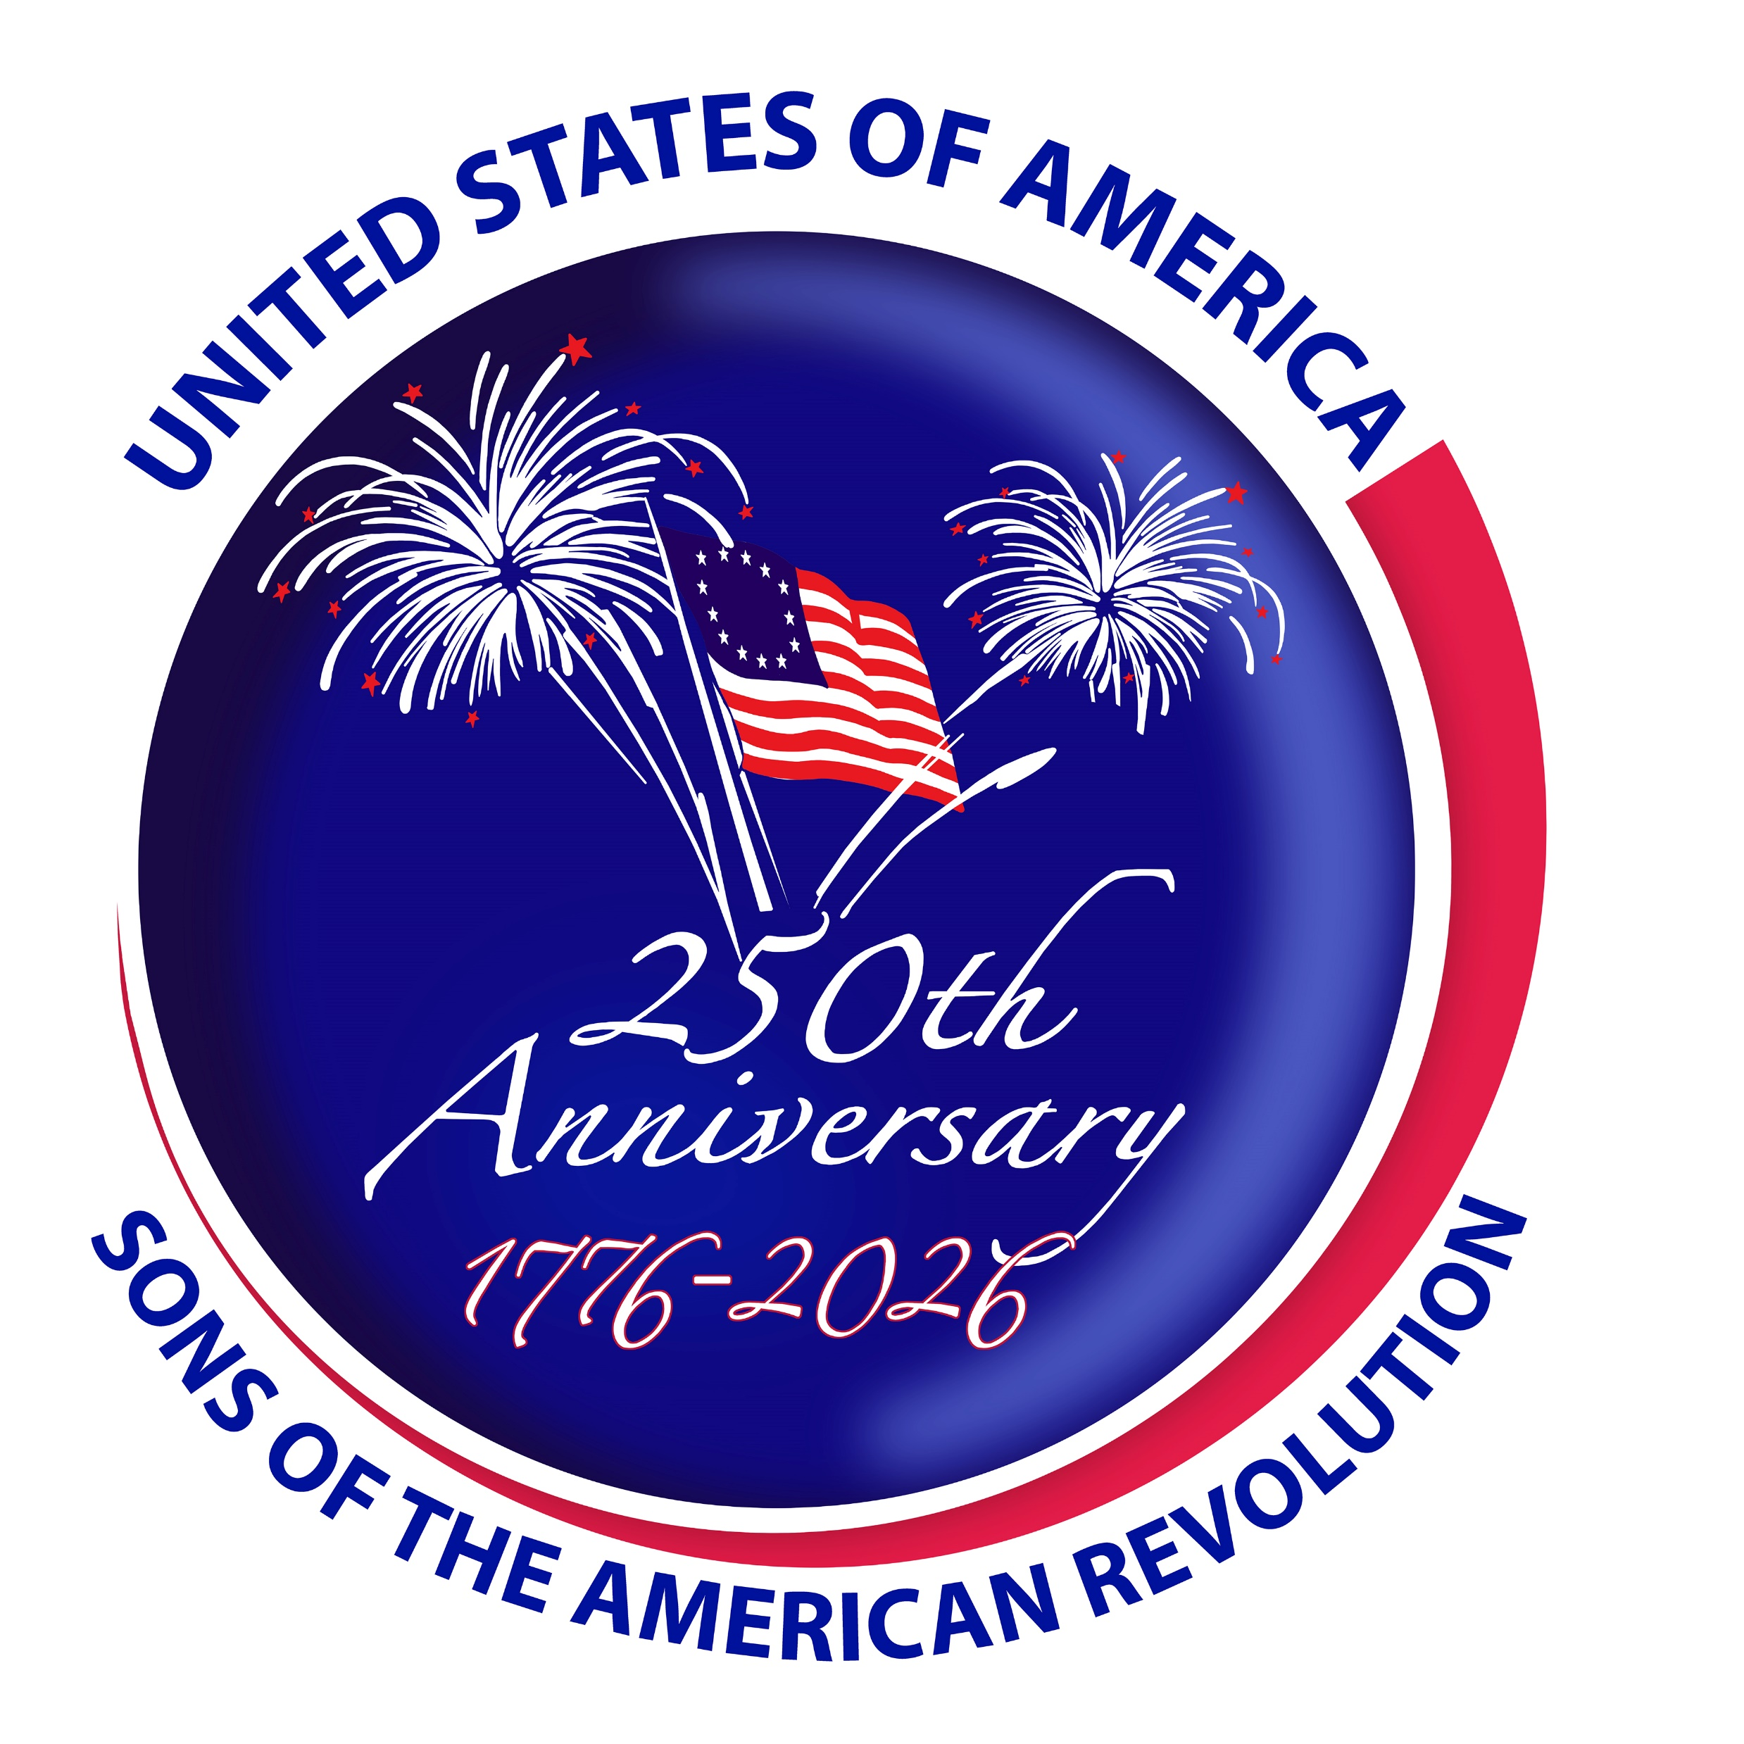
America 250 SAR Programs Committee
©Copyright 2024, text-Peter T. Young, design- Artists Gallerie, LLC

Slide 3
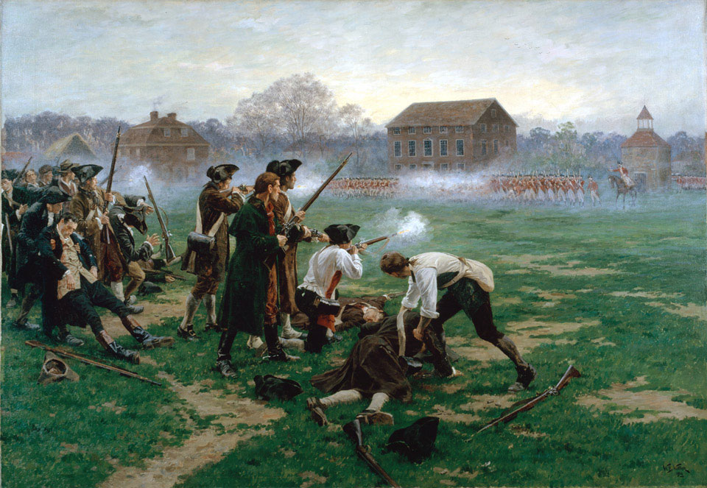
Lexington & Concord
“The Shot Heard Round the World”
April 19, 1775

Slide 4
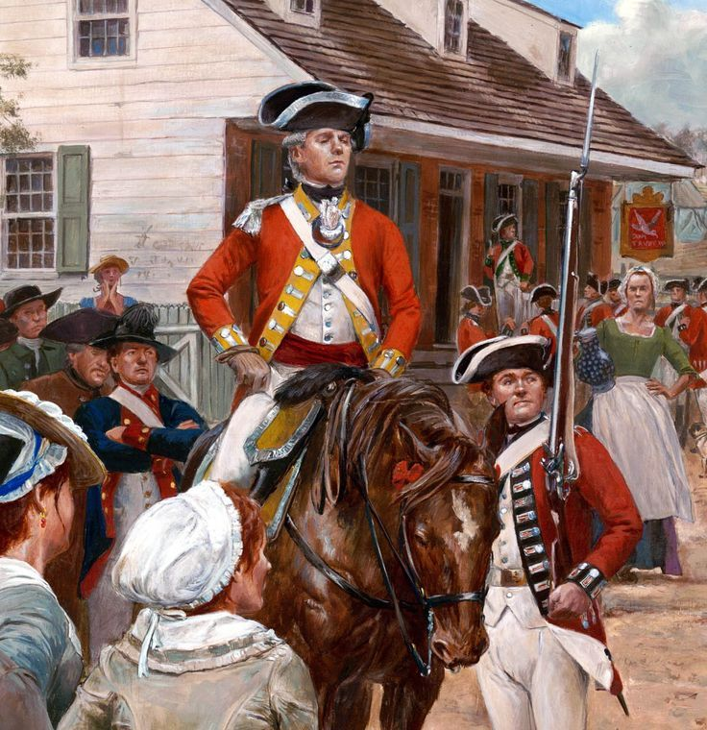
"Decade of the American Revolution“ – Lexington & Concord
“British Redcoats In America”
Notes:
In 1775 there were 7,000 British redcoats in America, with around 4,000 in Massachusetts itself.
The royally appointed governor, Thomas Gage, had been granted broadly expanded powers.

Slide 5
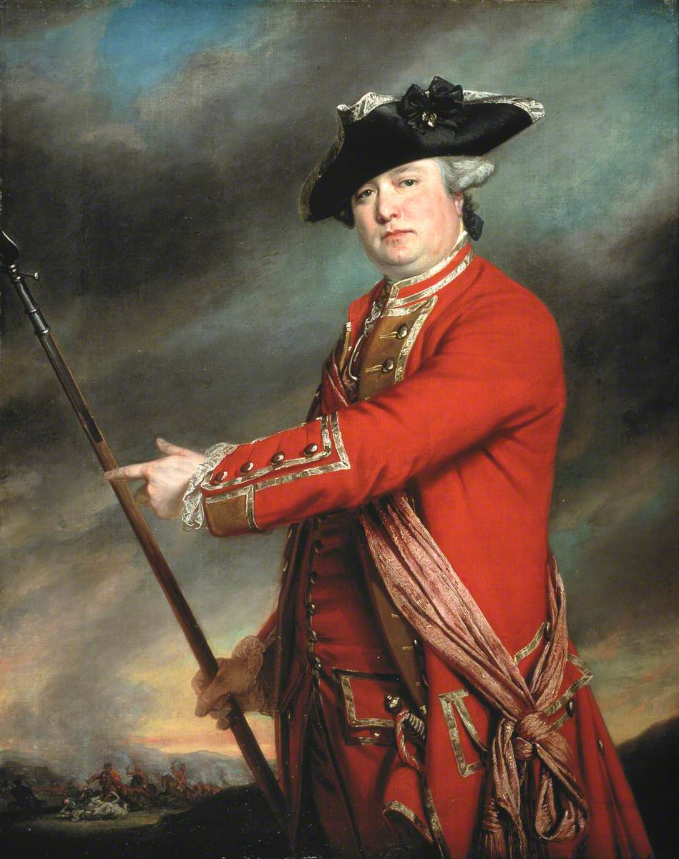
"Decade of the American Revolution“ - Lexington & Concord
“Rebellion was in the air”
Notes:
Rebellion was in the air.
Acting on intelligence that the militia were stockpiling weapons, Gage ordered British Lieutenant-Colonel Francis Smith to march to Concord and seize the arms.

Slide 6
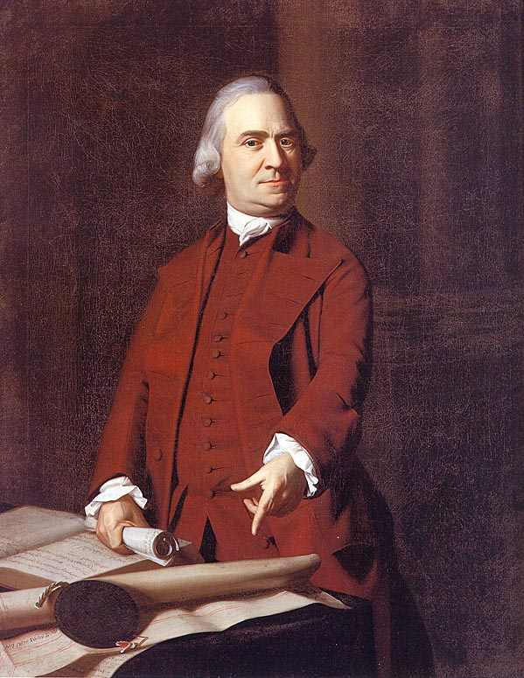
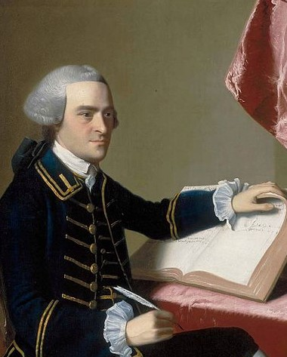
"Decade of the American Revolution“ - Lexington & Concord
“Capture Adams and Hancock”
Notes:
The rebel intelligence network suggested that the British aim in Lexington was to capture Samuel Adams and John Hancock, two of the prominent Patriot leaders.
But the size of the British army force was large enough to suggest they had bigger goals in mind.

Slide 7
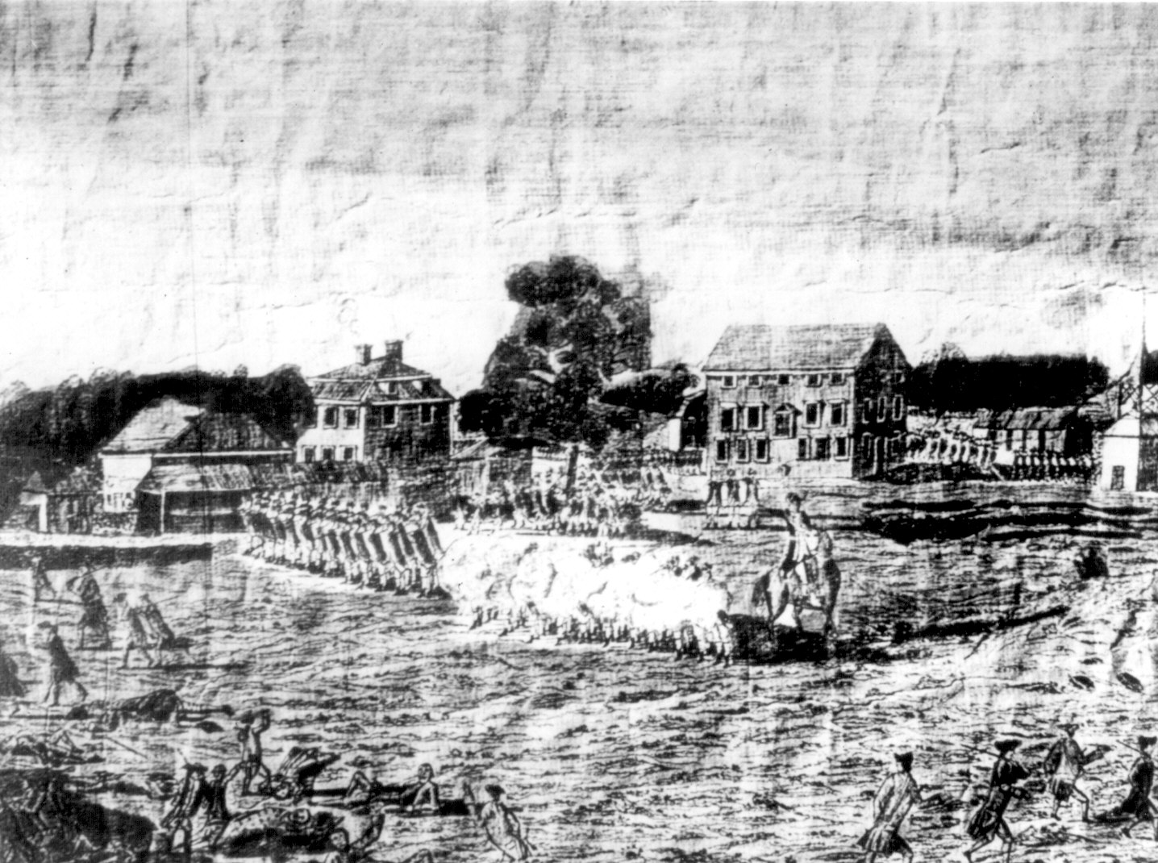
"Decade of the American Revolution“ - Lexington & Concord
“Lexington Green”
Notes:
The British soldiers and rebel militiamen raced to Lexington during the night; they confronted each other at Lexington Green - a village common area - just as the sun was rising on April 19.

Slide 8
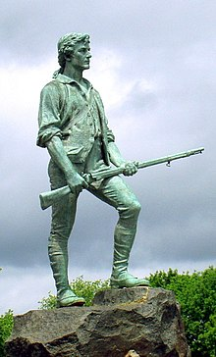
"Decade of the American Revolution“ - Lexington & Concord
“80 Lexington Minutemen”
Notes:
Captain John Parker, a veteran of the French and Indian War, led a contingent of 80 Lexington militiamen, known as minute men because they had to be ready to fight at a minute’s notice.
Most of the militiamen were farmers or tradesmen.
Non-uniformed, they were armed with a variety of firearms including muskets and fowling pieces.

Slide 9
"Decade of the American Revolution“ - Lexington & Concord
“April 19, 1775”
Notes:
On April 19, 1775, initial skirmishes between British regulars and American Patriots marked the beginning of the American Revolutionary War.
It is unclear who fired the first shot. A skirmish ensued, during which eight militiamen were killed and only one British soldier wounded.

Slide 10
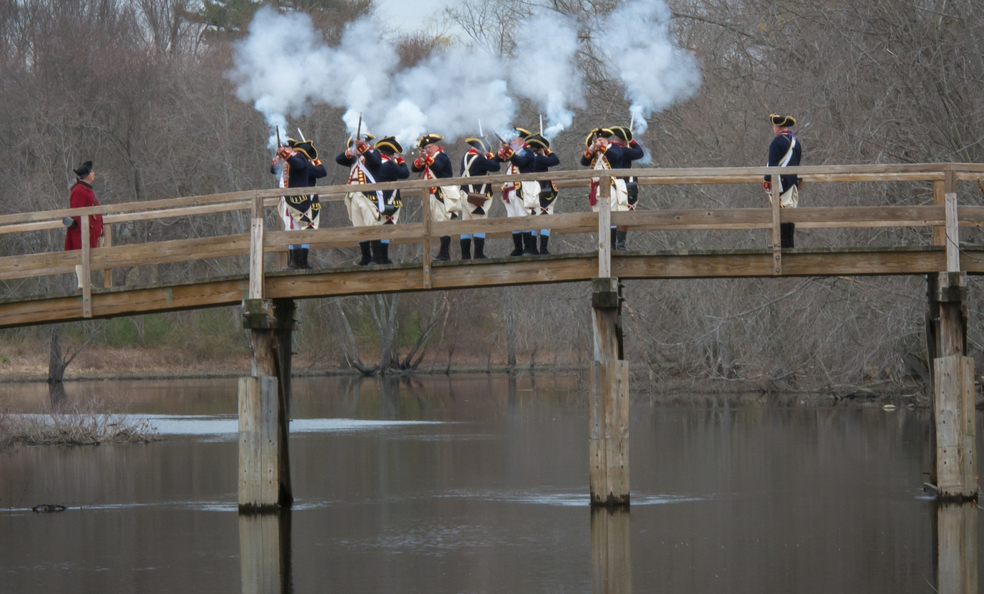
"Decade of the American Revolution“ - Lexington & Concord
“Concord”
Notes:
After order was restored, the British soldiers began the march to Concord. Total losses were American 95, British 273.
The Battles of Lexington and Concord roused New Englanders to join forces and begin the Siege of Boston, resulting in its evacuation by the British the following March.

Slide 11
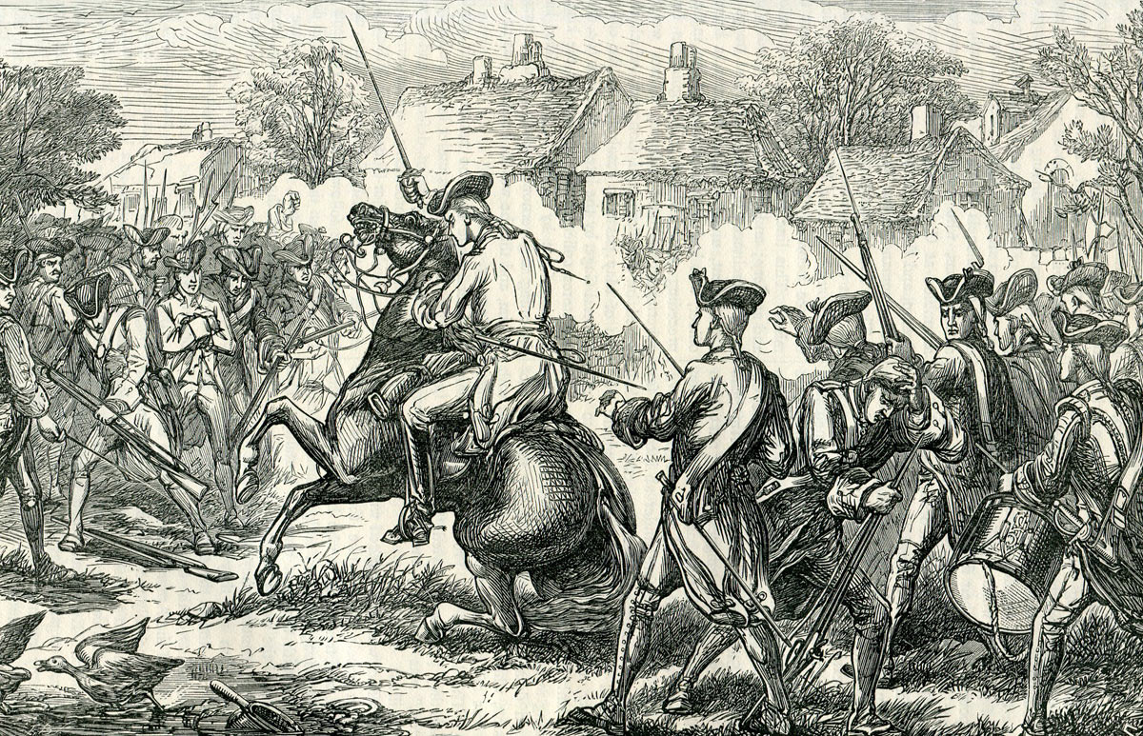
"Decade of the American Revolution“ - Lexington & Concord
Notes:
Lexington and Concord led many Americans to support the ‘revolution’.
They showed that American citizen soldiers could stand up to redcoats; something previously doubted by many on both sides.

Slide 12
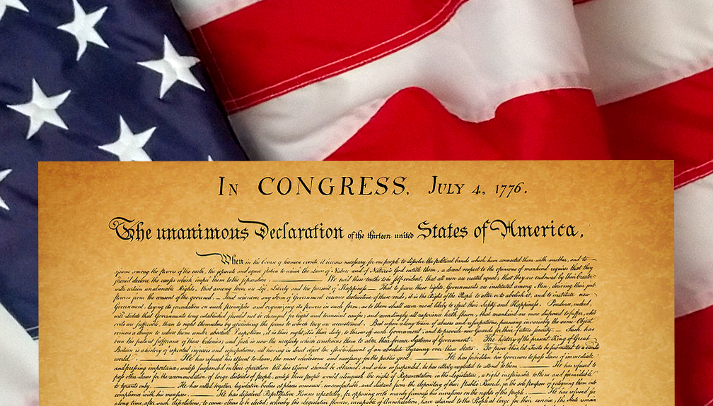
"Decade of the American Revolution“ - Lexington & Concord
“The United States”
Notes:
It was the turning point in the future of the continent and an everlasting change in what would become the United States.

Slide 13
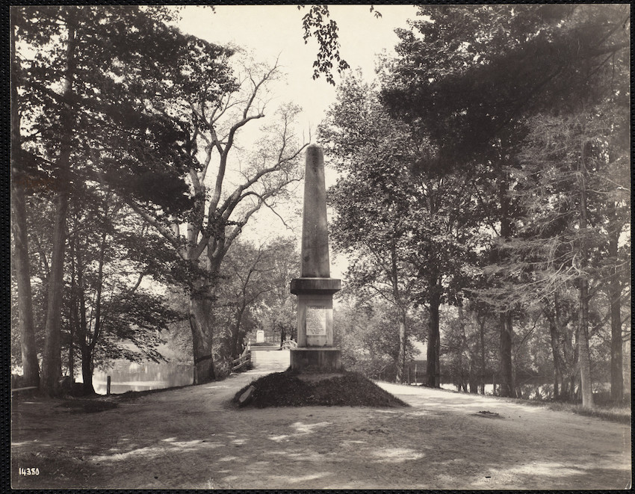
"Decade of the American Revolution“ - Lexington & Concord
“Shot Heard Round the World”
Notes:
It was Ralph Waldo Emerson who coined the phase ‘Shot Heard Round the World’ and used it his 1837 poem, ‘Concord Hymn,’ that he wrote for the dedication of a battle monument at the site of the North Bridge.

Slide 14
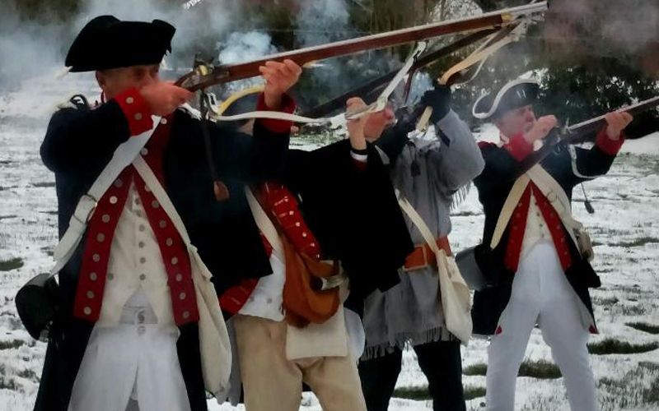
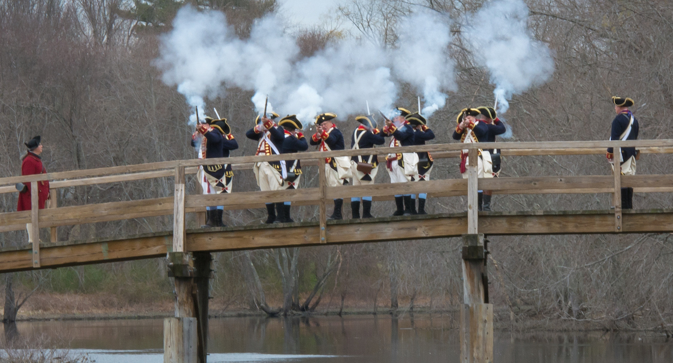
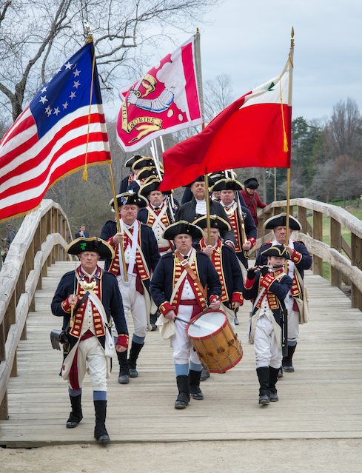
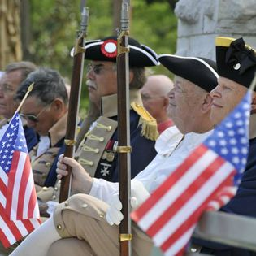
"Decade of the American Revolution“ - Lexington & Concord
Notes:
This is dedicated to the 250th Anniversary Celebration of the Declaration of Independence for more information visit the National Society Sons of the American Revolution website at: www.sar.org

Slide 15
America 250 SAR Programs Committee
America250sar.org
©Copyright 2024, text-Peter T. Young, design- Artists Gallerie, LLC

