Slide 2
America 250 SAR Programs Committee
©Copyright 2024, text-Peter T. Young, design- Artists Gallerie, LLC

Slide 3
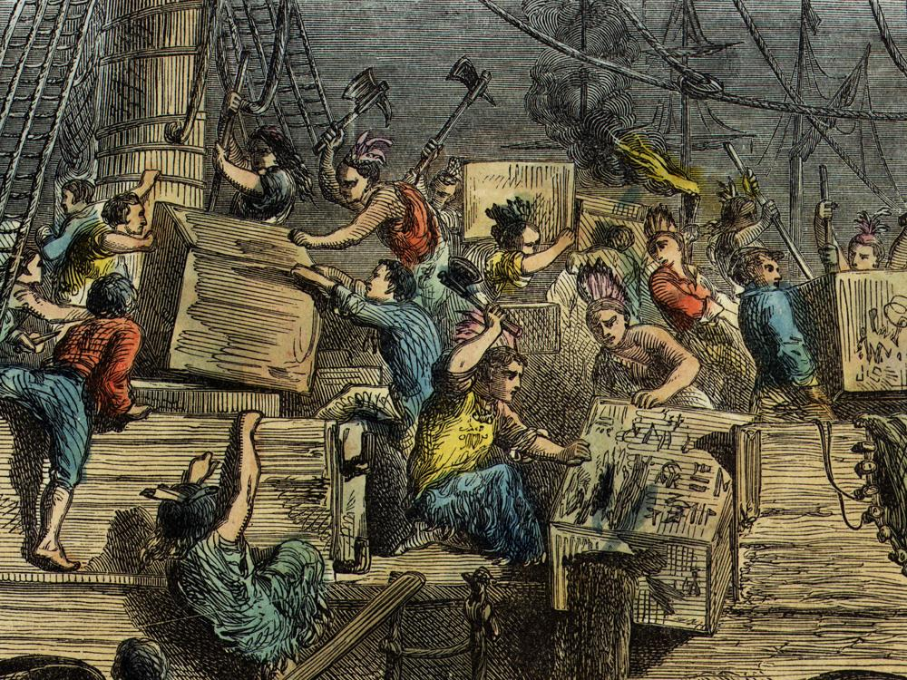
"Decade of the American Revolution“
Boston Tea Party
December 16, 1773

Slide 4
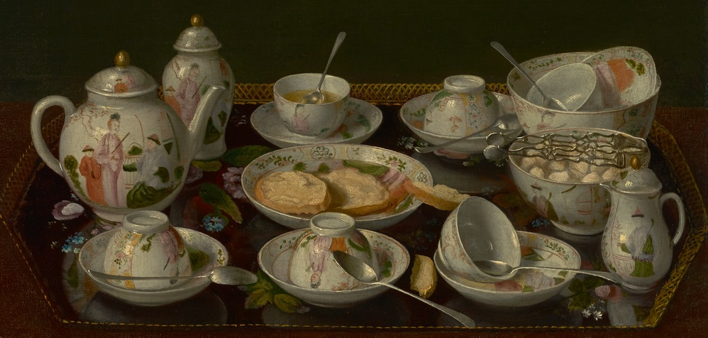
"Decade of the American Revolution“ – Boston Tea Party
“The practice of tea drinking arrived with colonists”
Notes:
The practice of tea drinking arrived with colonists from both England and the Netherlands and was already established by the mid-17th century, evidenced by the number of tea wares recorded in household inventories.

Slide 5
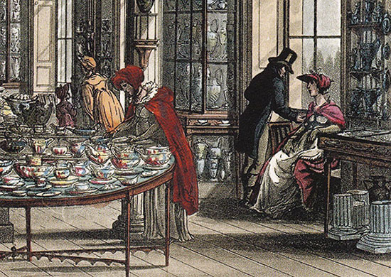
"Decade of the American Revolution“ – Boston Tea Party
“Tea Act in 1773”
Notes:
America was becoming a country of tea drinkers. However, due to debt due to the costs associated with the French and Indian Wars, Parliament imposed new taxes, including the Tea Act in 1773.

Slide 6
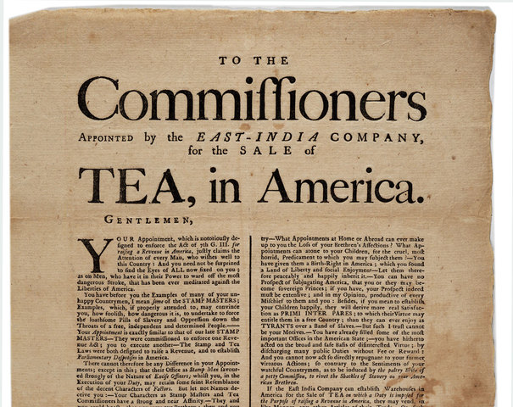
"Decade of the American Revolution“ – Boston Tea Party
“Bail out the struggling East India Co”
Notes:
The Tea Act was intended to bail out the struggling East India Co., which was very important for the British economy, and the Tea Act would raise revenue from the 13 colonies.

Slide 7
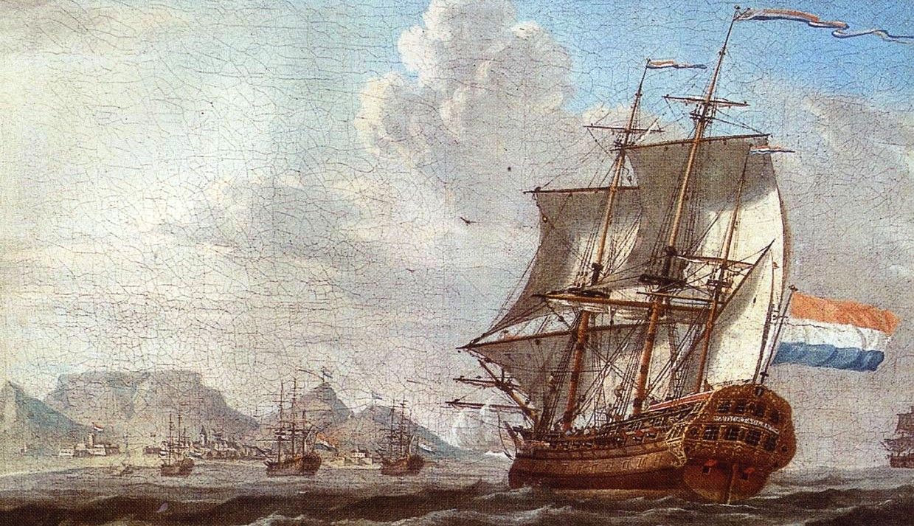
"Decade of the American Revolution“ – Boston Tea Party
“Directly ship tea to the colonies”
Notes:
The Tea Act allowed the East India Co. to directly ship tea to the colonies without passing England.
This way, duties were reduced and resulted in the cheaper price of English tea in the colonies. The Tea Act received royal assent on May 10, 1773.

Slide 8
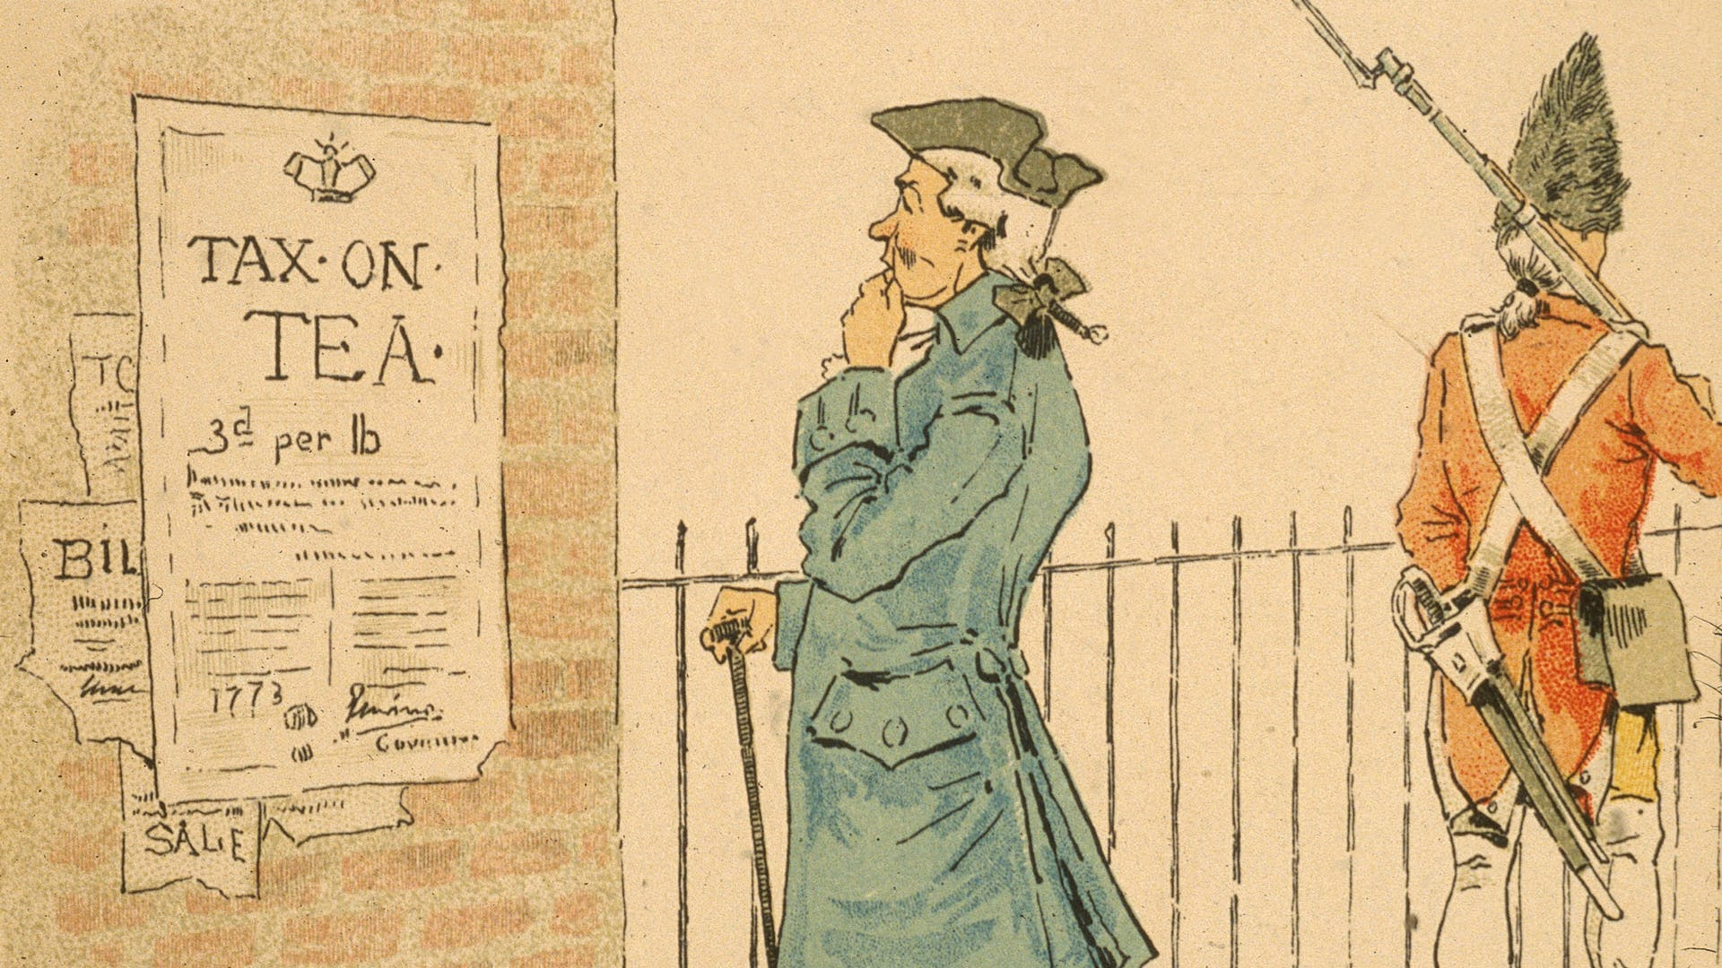
"Decade of the American Revolution“ – Boston Tea Party
“The colonists resisted the Tea Act”
Notes:
The colonists resisted the Tea Act more because it violated the principle of self-government by consent than because they could not afford the tax, which had existed since the passage of the 1767 Townshend Revenue Act.

Slide 9
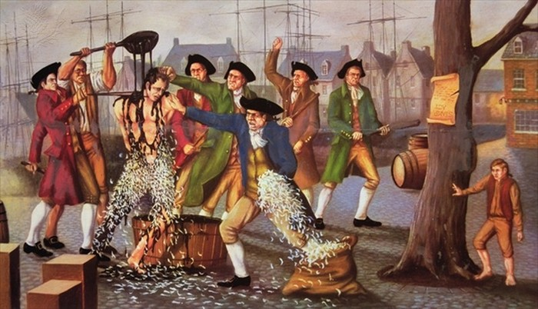
"Decade of the American Revolution“ – Boston Tea Party
“Citizens threatened tax collectors”
Notes:
Citizens prevented British tea from being unloaded, threatened tax collectors into resigning, and protested taxation without representation.

Slide 10
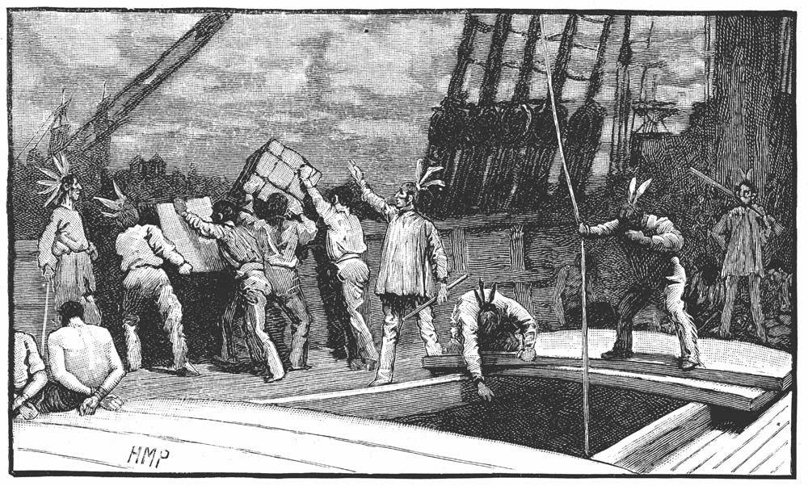
"Decade of the American Revolution“ – Boston Tea Party
“December 16, 1773”
Notes:
On December 16, 1773, one day before the deadline for the landing of the tea, more than 7,000 gathered in the Old South Meeting House, Boston’s largest building.
Then, dozens of colonists, dressed like Mohawk Indians as a symbol of American freedom and to disguise their identities from British authorities, entered the assembly with war whoops.

Slide 11
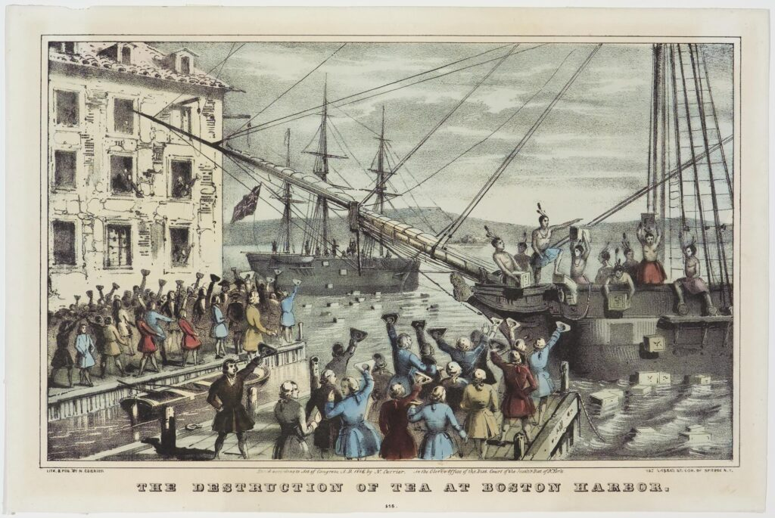
"Decade of the American Revolution“ – Boston Tea Party
“Band of Mohawk impersonators boarded the three ships”
Notes:
Thousands of citizens spilled into the streets and watched as the band of Mohawk impersonators boarded the three ships and dumped into the harbor 342 chests of tea belonging to the British East India Company.

Slide 12
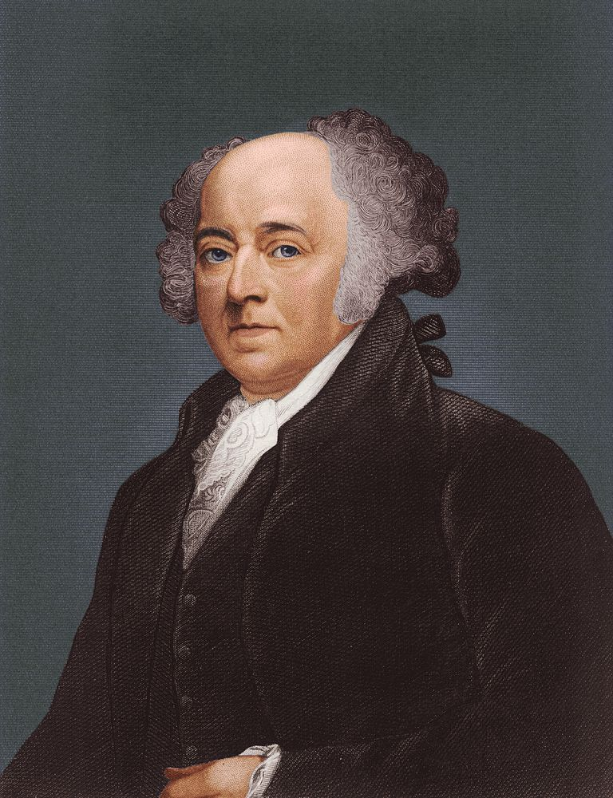
"Decade of the American Revolution“ – Boston Tea Party
“John Adams rejoiced”
Notes:
Although some colonists saw the Boston Tea Party as a destructive mob action, most praised the protest.
John Adams rejoiced, “This is the most magnificent Movement of all. There is a Dignity, a Majesty, a Sublimity, in this last Effort of the Patriots, that I greatly admire.”

Slide 13
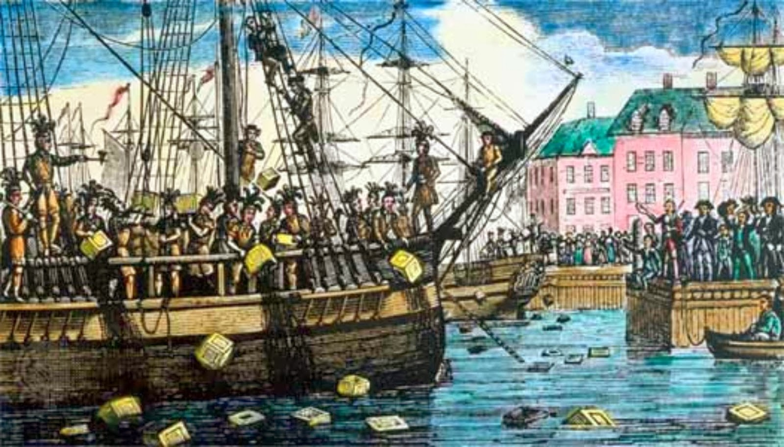
"Decade of the American Revolution“ – Boston Tea Party
“This Destruction of the Tea…”
Notes:
“The People should never rise, without doing something to be remembered - something notable And striking.”
“This Destruction of the Tea is so bold, so daring, so firm, intrepid and inflexible, and it must have so important Consequences, and so lasting …”

Slide 14
America 250 SAR Programs Committee
America250sar.org
©Copyright 2024, text-Peter T. Young, design- Artists Gallerie, LLC

