Slide 2
America 250 SAR Programs Committee
©Copyright 2024, text-Peter T. Young, design- Artists Gallerie, LLC

Slide 3
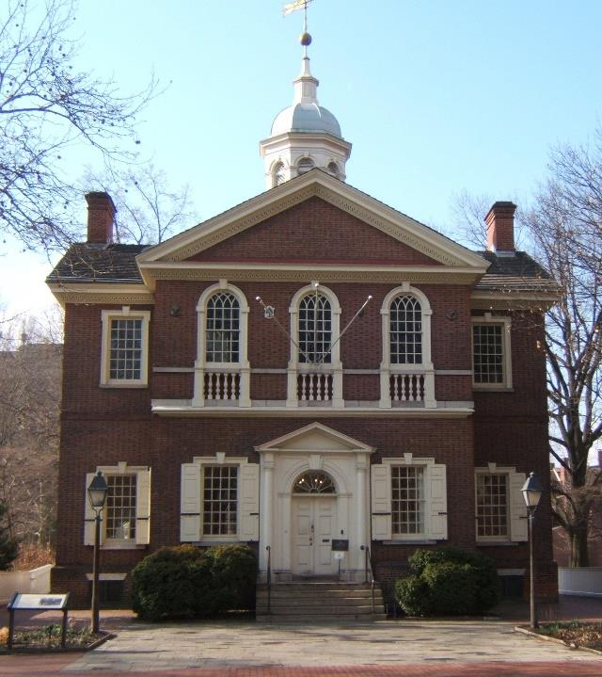
First Continental Congress
September 5 October 26, 1774

Slide 4
"Decade of the American Revolution“ - First Continental Congress
“Intolerable Acts”
“Boston under martial law”
Boston Port Act
Massachusetts Government Act
Administration of Justice Act
Quartering Act
Quebec Act
Notes:
In 1774, the British Parliament passed a series of laws collectively known as the Intolerable Acts, with the intent to suppress unrest in colonial Boston by closing the port and placing it under martial law.

Slide 5
"Decade of the American Revolution“ - First Continental Congress
“Intolerable Acts”
“Royal Navy blockades Boston Harbor”
Boston Port Act
Massachusetts Government Act
Administration of Justice Act
Quartering Act
Quebec Act
Notes:
Passed in March 1774, shut down Boston Harbor until the East India Company was
repaid. The act authorized the Royal Navy to blockade Boston Harbor because “the commerce of his Majesty’s subjects cannot be safely carried on there.” The blockade commenced on June 1, 1774, effectively closing Boston’s port to commercial traffic. Additionally, it forbade any exports
to foreign ports or provinces. The only imports allowed were provisions for the British Army and necessary goods, such as fuel and wheat.

Slide 6
"Decade of the American Revolution“ - First Continental Congress
“Intolerable Acts”
“Replace elective local council with
military governor”
Boston Port Act
Massachusetts Government Act
Administration of Justice Act
Quartering Act
Quebec Act
Notes:
May 20, 1774, abolished the colony’s charter of 1691, reducing it to the level of a crown colony, replacing the elective local council with an appointive one, enhancing the powers of the military governor, Gen. Thomas Gage, and forbidding town meetings without approval.

Slide 7
"Decade of the American Revolution“ - First Continental Congress
“Trial
of a crown officer
to England”
“Intolerable Acts”
Boston Port Act
Massachusetts Government Act
Administration of Justice Act
Quartering Act
Quebec Act
Notes:
May 20, 1774, was aimed at protecting British officials charged
with capital offenses during law enforcement. It allowed the royal governor to unilaterally move
any trial of a crown officer out of Massachusetts, a change designed to prevent hostile Massachusetts juries from deciding these cases.

Slide 8
"Decade of the American Revolution“ - First Continental Congress
“Intolerable Acts”
“Unoccupied buildings to house British troops”
Boston Port Act
Massachusetts Government Act
Administration of Justice Act
Quartering Act
Quebec Act
Notes:
(June 2, 1774) revived the indignation that surrounded the earlier Quartering Act, which had been allowed to expire in 1770. The new Quartering Act applied to all British America and gave colonial governors the right to requisition unoccupied buildings to house British troops. However, in Massachusetts the British troops were forced to remain camped on the Boston Common until the following November because the Boston patriots refused to allow workmen to repair the vacant buildings General Gage had obtained for quarters.

Slide 9
"Decade of the American Revolution“ - First Continental Congress
“Intolerable Acts”
“The free exercise of the religion of the Church of Rome”
Boston Port Act
Massachusetts Government Act
Administration of Justice Act
Quartering Act
Quebec Act
Notes:
June 22, 1774, expanded the boundaries of Quebec westward. The Act also granted “the free Exercise of the Religion of the Church of Rome,” as the territory was home to a large French Catholic majority.

Slide 10
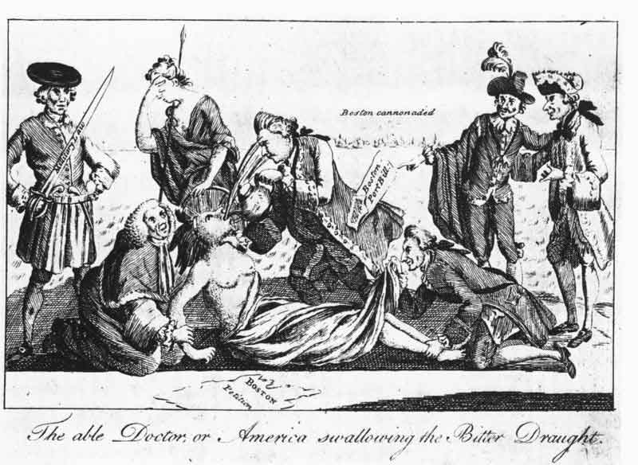
"Decade of the American Revolution“ - First Continental Congress
“Colonists
rose in solidarity with Massachusetts”
Notes:
Across North America, colonists rose in solidarity with the people of Massachusetts.
Goods arrived in Massachusetts from as far south as Georgia, and by late spring 1774, nine of the colonies called for a continental congress

Slide 11
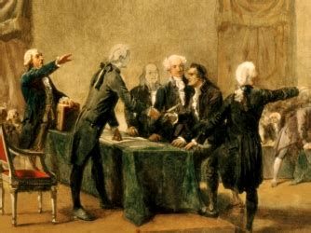
"Decade of the American Revolution“ - First Continental Congress
Virginia’s Committee of Correspondence originating the invitation.
Notes:
Virginia’s Committee of Correspondence is largely credited with originating the invitation. The colony of Connecticut was the first to respond.

Slide 12
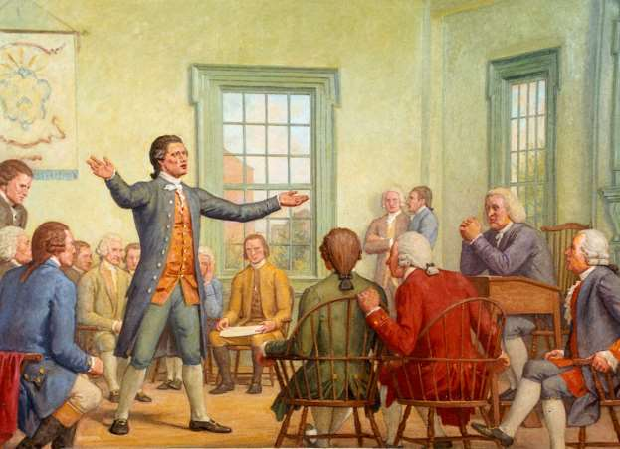
"Decade of the American Revolution“ - First Continental Congress
“Delegates would set terms for a boycott”
Notes:
Colonial legislatures empowered delegates to attend a Continental Congress which would set terms for a boycott

Slide 13
"Decade of the American Revolution“ - First Continental Congress
“Delegates elected by their legislatures or committees of correspondence”
Notes:
The colonies elected delegates to the First Continental Congress in various ways.
Some delegates were elected through their respective colonial legislatures or committees of correspondence.

Slide 14
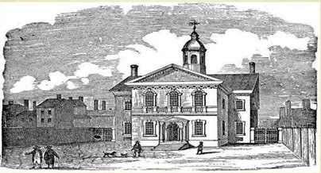
"Decade of the American Revolution“ - First Continental Congress
“Carpenters’ Hall Philadelphia,
Sept. 5,
1774”
Notes:
The Congress first convened in Carpenters’ Hall in Philadelphia, PA on Sept. 5, 1774, with delegates from each of the 13 colonies except Georgia. (Georgia was facing a war with Native American tribes and the colony did not want to jeopardize British assistance.)

Slide 15
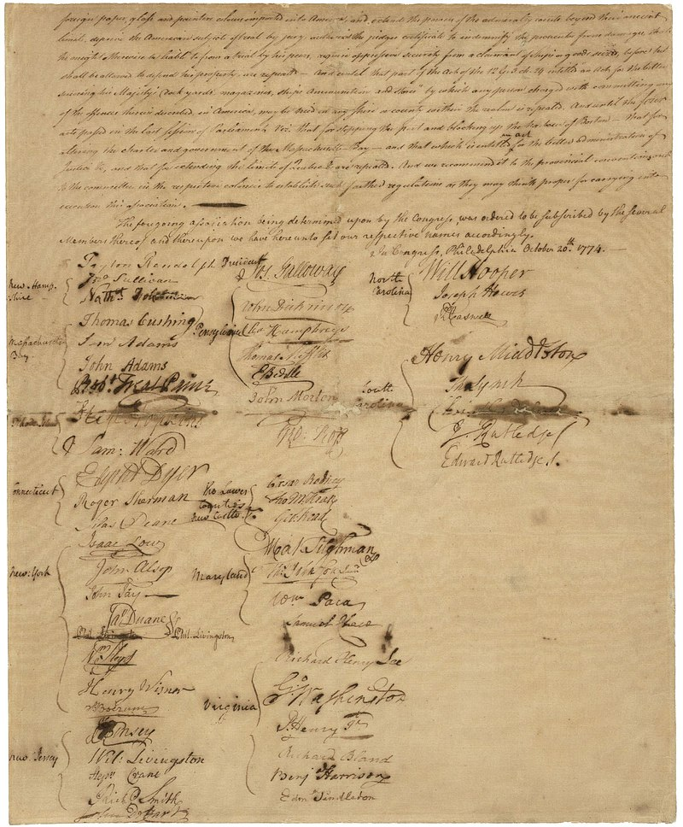
"Decade of the American Revolution“ - First Continental Congress
“First Continental Congress adopted their Declaration & Resolves”
Notes:
On October 14, 1774, the First Continental Congress adopted their Declaration & Resolves. This stated the group’s objections to the Coercive Acts, listed the rights of the colonists, and itemized objections to British rule beyond the Intolerable Acts.

Slide 16
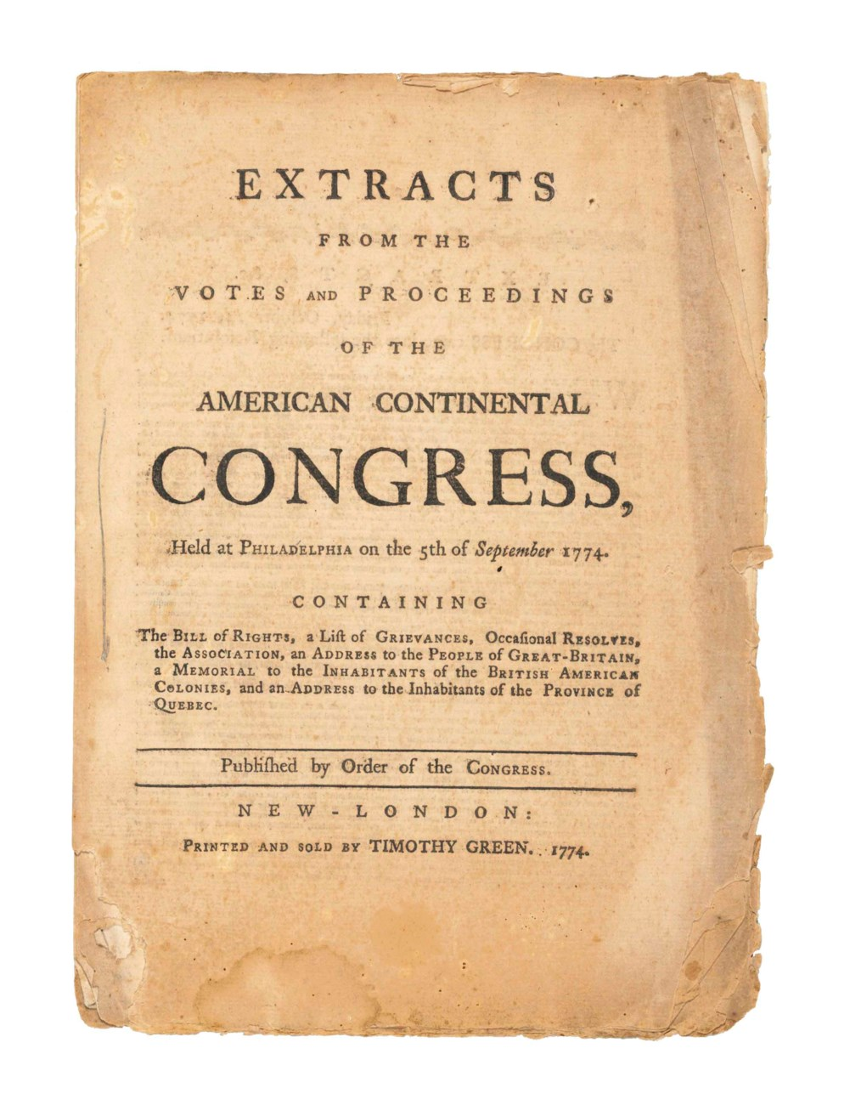
"Decade of the American Revolution“ - First Continental Congress
“That foundation of English liberty, and of all free government”
Notes:
The list of rights insisted that Colonists were “entitled to life, liberty, and property” and “that foundation of English liberty, and of all free government, is a right in the people to participate in their legislative council”.

Slide 17
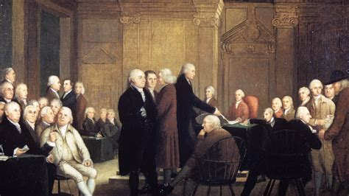
"Decade of the American Revolution“ - First Continental Congress
“Adopted a
petition to
the king”
Notes:
Finally, at the end of the first continental congress, the delegates adopted a petition addressed to “the king's most excellent majesty” on October 26, 1774.

Slide 18
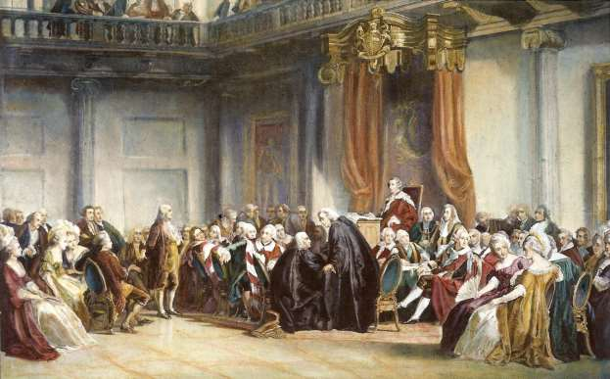
"Decade of the American Revolution“ - First Continental Congress
“Many delegates were skeptical”
Notes:
Many delegates were skeptical about changing the king’s attitude towards the colonies but believed that every opportunity should be exhausted to de-escalate the conflict before taking more radical action.

Slide 19
"Decade of the American Revolution“ - First Continental Congress
“WAR”
Notes:
By the time Congress met again, war was already underway, and thus, the delegates to the Second Continental Congress formed the Continental Army and put George Washington in charge of it.

Slide 20
America 250 SAR Programs Committee
America250sar.org
©Copyright 2024, text-Peter T. Young, design- Artists Gallerie, LLC

